Slide 1
TELECOM CUSTOMER CHURN RATE
PROBLEM STATEMENT:- Exploring on the actions of telecom clients to update the quit probability of consumers based on their past events using EDA and few other evaluation metrics in order to forecast the chances of consumers to leave telecom.
PROBLEM DESCRIPTION:- predicting consumers who quit with in previous month through churn column included in dataset.
services that every single client subscribed with – phone services, numerous lines, web services, online network security, device safety, online data retrieval, technological assistance, live streaming videos, tv’s and audio.
Consumer profile details – subscribing time of clients, contract information, type of payments, paper bills for payment and invoice, every month bill and total amount.
Statistical information regarding data – age, group, gender and associated partners.

Slide 2
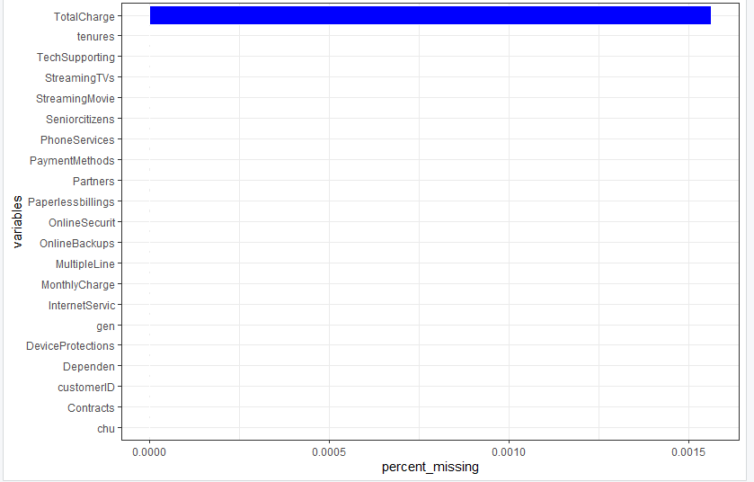
Statistical analysis of the dataset using R
DATA CLEANING:- 11 missing data rows present in total charges column, so cleaning those rows in total charges section.
Three continuous variables present in the dataset are tenure , monthly charge and total charge.
Senior citizen column needs to be converted into integer form to categorical form.
FIG1:- VISUALIZATION OF NA’S IN DATASET

Slide 3
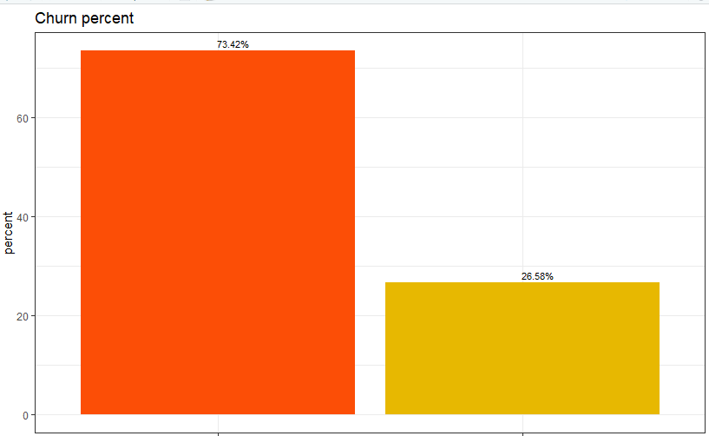
Churn field explains us with sum of consumers who quit in the previous month
Almost 27 precent got out from the sector in previous month alone.
FIG2:- VISUALIZATION OF CATEGORICAL DATA FIRSTLY COMPARED WITH CHURN

Slide 4
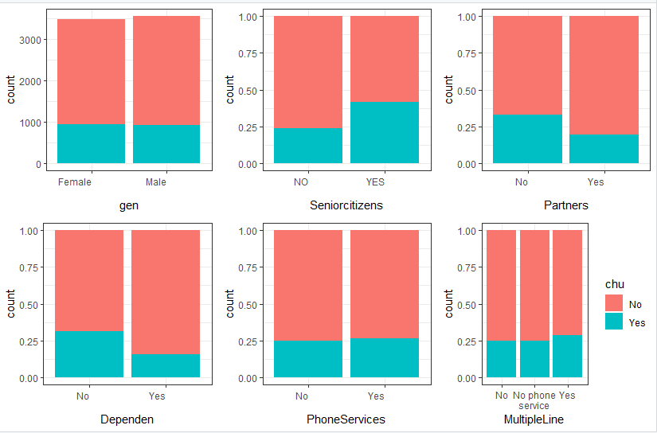
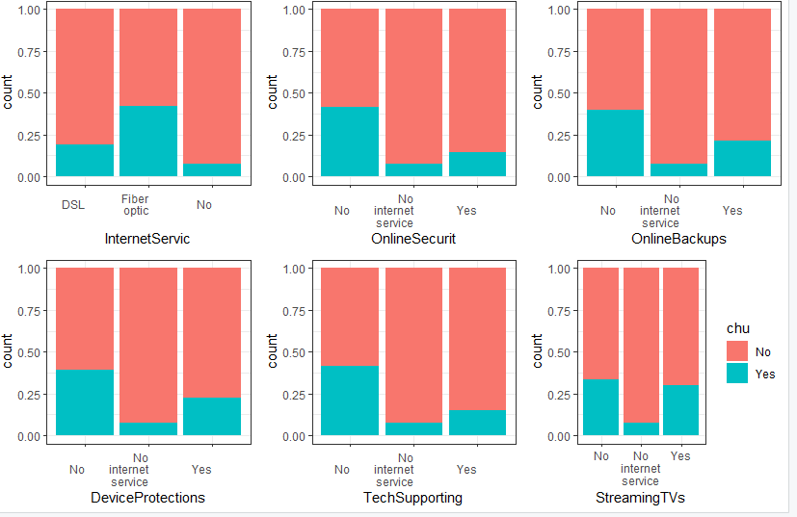
When it comes to gender in churn rates it is nearly same in the scenario of males and females in fig 3.
The rate of churn is greater in the field of senior citizens in fig 3.
Partners and dependent clients have less churn percent in contrast with fields consisting without partners and dependents in fig3.
FIG 3: ANALYSING CHURN RATES FIG4
Churn percent is more greater in the field of Fiber optic internet service in fig 4.
Clients without features like tech supporting, online backups and online security have quit in past month alone in fig 4.

Slide 5
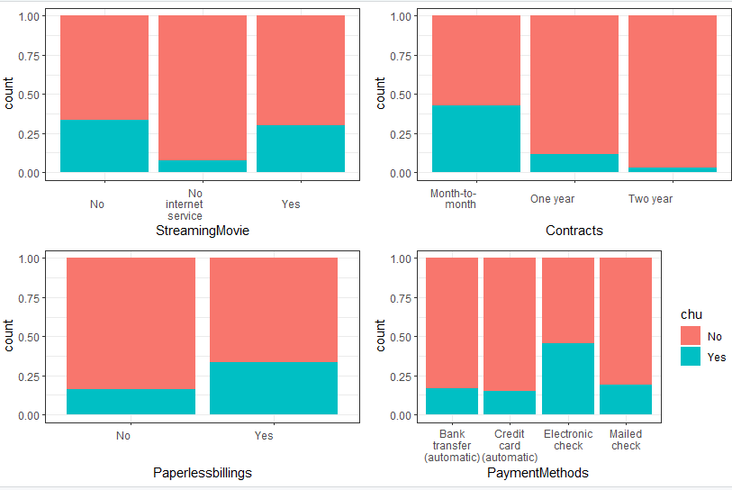
The more rate of clients subscribed for monthly package quit in contrast with clients who subscribe for two or more months in fig 6
Churn rate is greater in the field of consumers with paperless billing service in fig 6.
The probability of leaving is high in clients with Electronic check payment option than with other options in fig 6.
FIG6

Slide 6
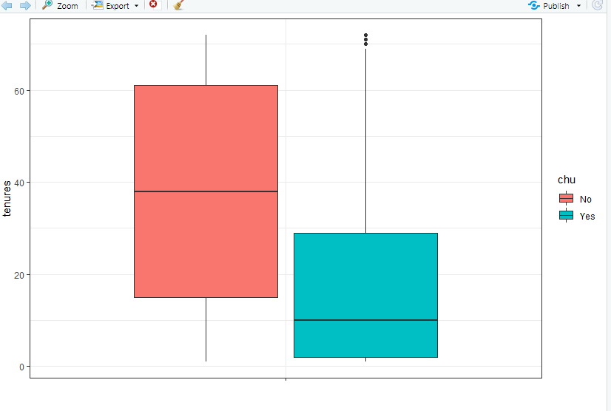
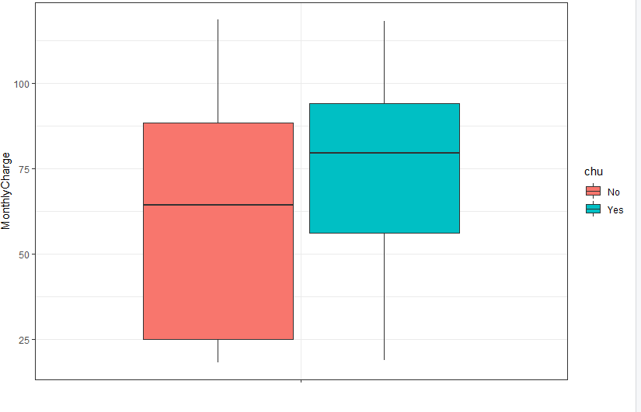
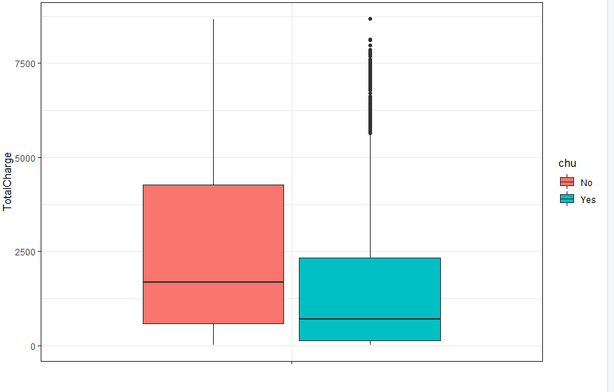
ANALYSIS OF CONTINOUS VARIABLES WITH RESPECT TO CHURN
TENURE: the median tenures for consumers who quit is about TEN months in fig 7.
FIG 7. FIG 8. FIG 9.
Monthly charges: the median is more than 75 for consumers who have churned with elevated monthly charges in fig 8.
Total charge : the median is very less for consumers of total charge with churned in fig 9.

Slide 7
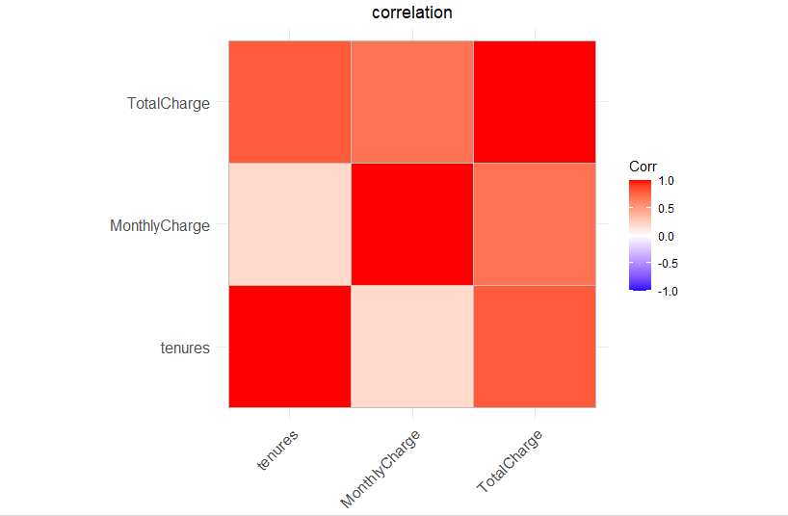
ANALYSING CORRELATION AMONG CONTINOUS CONTINUOS VARIABLES.
Tenure and total charge having correlation more than ‘0’
Monthly charges having correlation equal to ‘0’.
FIG 10

Slide 8
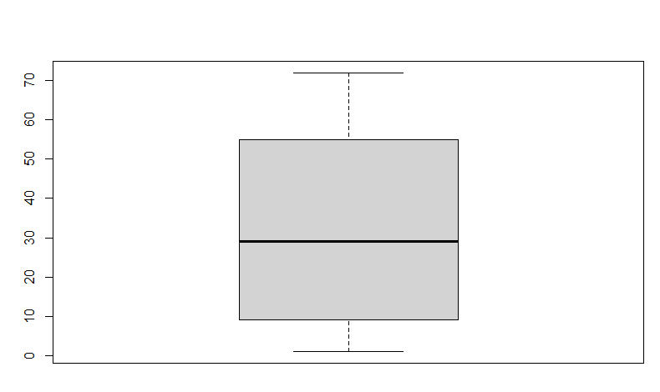
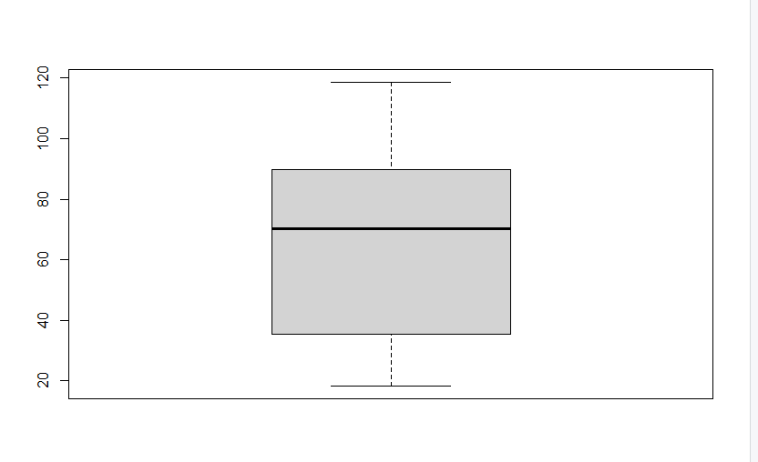
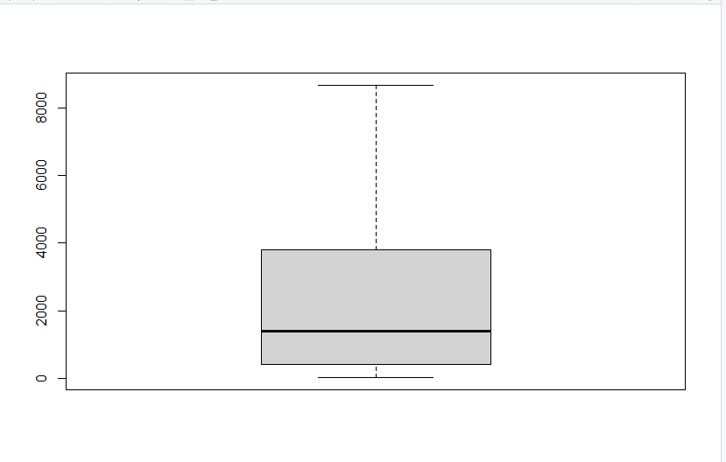
It is looking like no value is behind the whiskers line while analysing for outliers in continuos attributes.
FIG 11 FIG 12 FIG 13

Slide 9
DATA PREPROCESSING
Data preprocessing involves:
removing categorical variables.
Creating standard continuous attributes.
Making derived attributes.
Making dummy attributes for factor attributes.
Designing end dataset.
Dividing the dataset into train and test dataset.

Slide 10
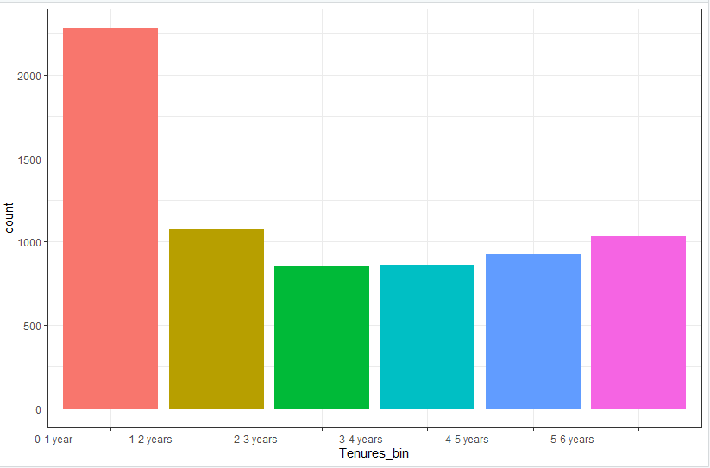
MAKING DERIVED FEATURES
Make a derived set of attributes for tenure field with numerous bins for tenure like ‘0-1’, ‘1-2’, years and compare the attributes.
After comparing each attribute it seems to be more sums of consumers with tenures ‘0-1’ or ‘1-2’ years when compared with other terms.

Slide 11
MODEL BULDING WITH LOGISTIC REGRESSION.
Performing model 1 utilizing all variables with logistic regression
Deviance Residuals:
Min 1Q Median 3Q Max
-2.1047 -0.6793 -0.2708 0.6638 3.3606
Utilizing stepAIC for choosing attributes to obtain efficient analysis of ouput by appending or deleting variables.
Dispersion parameter for binomial family taken to be 1)
Null deviance: 6513.9 on 5624 degrees of freedom
Residual deviance: 4586.9 on 5596 degrees of freedom
AIC: 4644.9
Number of Fisher Scoring iterations: 6

Slide 12
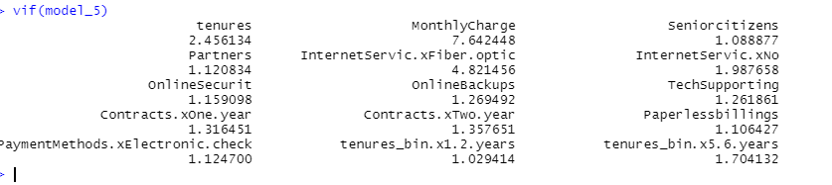
Analysing model 2 with selected variables utilizing variance inflation factor for cleaning unnecessary attributes consisting more multicollinearity among them. Multicollinearity presents when multiple predicting attributes are mostly similar with every one variable and then it results very hard to learn the effect of an independent attribute on dependent attribute.
The variance inflation factor(VIF) is utilised to calculate the multicollinearity among predicting attributes in a model. A predicting attributes with VIF 2 or low is deemed to be normal. More the VIF value the more chances of similarities among other predicting attributes. In this model we can eliminate the predictor attributes after checking importance of predictor attributes with more VIF and P-value.

Slide 13
EVALUATION OF MODEL USING VALIDATION DATA
Min. 1st Qu. Median Mean 3rd Qu. Max.
0.004869 0.040835 0.182065 0.259236 0.446210 0.862975
pred_chu
actual_chu No Yes
No 935 98
Yes 201 173
Accuracy
0.7782516
Sensitivity
0.7165775
Specificity
0.8005808

Slide 14
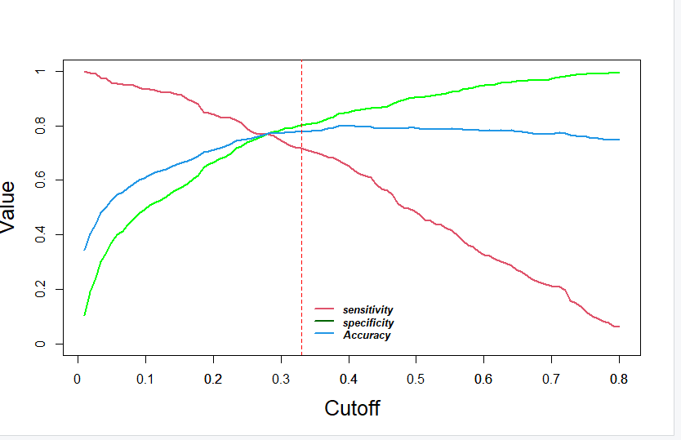
COMPARING ACCURACY, SPECIFICITY AND SENSITIVITY OF THREE MODELS IN LOGISTIC REGRESSION MODEL.
FIG15

Slide 15
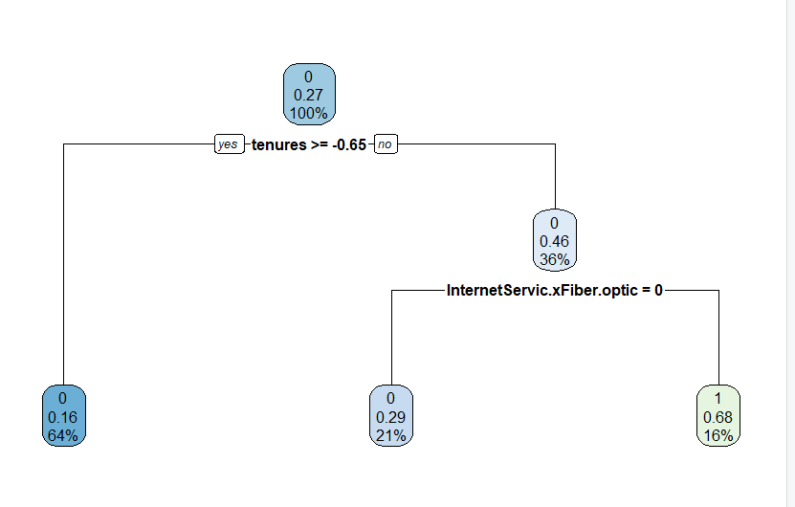
MODEL BUILDING 2 DECISION TREE
DECISION TREE: divides the data into numerous pairs and each pair consists subsets to form a tree like structure finally to made a prediction. Homogeneity is the fundamental method utilized to decide the variable on which a division should be make. A division that outcomes into most similar subset is frequently determined suitable and the process repeats for each subset to choose most homogenous subset then this homogeneity can be calculated with information gain, Entropy and Gini Index.
FIG 16

Slide 16
Training the decision tree with all variables with validation data and evaluation metrics using confusion matrix
Confusion Matrix and Statistics
Reference
Prediction 0 1
0 967 66
1 232 142
Accuracy : 0.7882
95% CI : (0.7659, 0.8093)
No Information Rate : 0.8522
P-Value [Acc > NIR] : 1
Kappa : 0.3679

Slide 17
Mcnemar's Test P-Value : <2e-16
Sensitivity : 0.8065
Specificity : 0.6827
Pos Pred Value : 0.9361
Neg Pred Value : 0.3797
Prevalence : 0.8522
Detection Rate : 0.6873
Detection Prevalence : 0.7342
Balanced Accuracy : 0.7446
'Positive' Class : 0
The decision tree model has high accuracy and sensitivity when compared with logistic regression model but when its comes to specificity it is less than logistic regression.

Slide 18
Modelling building 3 using random forest
RandomForest: frequently called as group of huge sums of Decision trees. That utilizes Bootstrapped aggregation method to select arbitrary values from dataset to train every single tree in forest. The resulting forecast in a random forest is the total sum of prediction of every single tree. Main use of random forest is that it predicts out-of-bag(OOB) error approximate gives the average error prediction of training protocols. Utilizing the trees consisting without training values in their bootstrap protocols which interprets the characteristics of cross validation error to avoid test and validation.
OOB estimate of error rate: 19.86%
The model generates accuracy of 80% according to OOB estimate of error rate.
Reference
Prediction 0 1
0 937 96
1 199 175

Slide 19
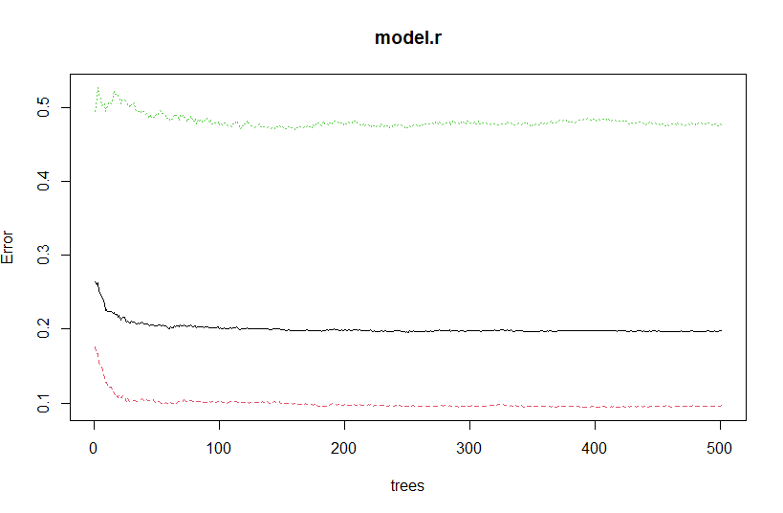
PERFORMING CONFUSING MATRIX ON RANDOM FOREST MODEL:
Accuracy : 0.7903
95% CI : (0.7681, 0.8113)
No Information Rate : 0.8074
P-Value [Acc > NIR] : 0.95
Kappa : 0.4111
Mcnemar's Test P-Value : 2.873e-09
Sensitivity : 0.8248
Specificity : 0.6458
Pos Pred Value : 0.9071
Neg Pred Value : 0.4679
Prevalence : 0.8074
Detection Rate : 0.6660
Detection Prevalence : 0.7342
Balanced Accuracy : 0.7353
The fundamental random forest model with accuracy : 79.03%, sensitivity : 80.74%, specificity 0.6458

Slide 20
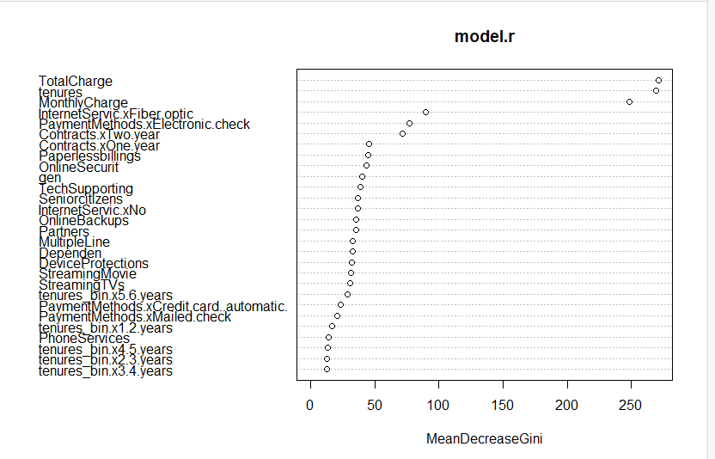
VARIABLE IMPORTANCE PLOT
VARIABLE IMPORTANCE PLOT: variable importance plot illustrates the highly important variable in reducing order by average reduce in Gini. The average reduction in Gini calculates the efficiency of each node at the resultant tree . The more the Gini index and the higher is homogeneity.

Slide 21
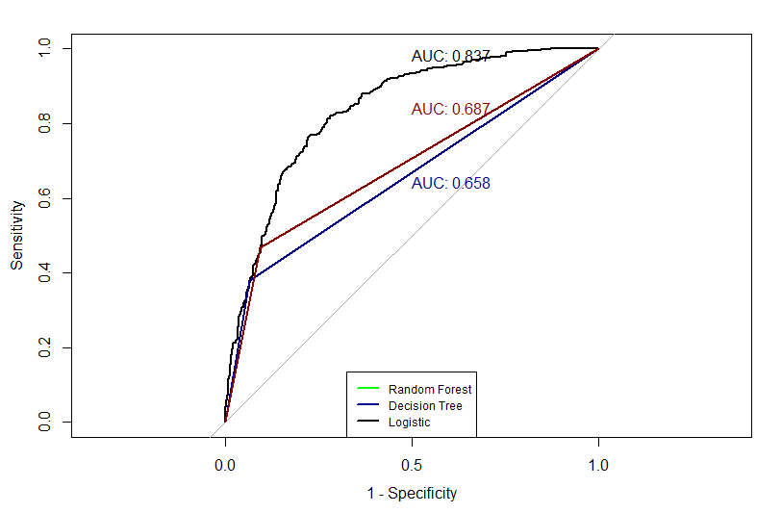
Checking the AUC-ROC of all three models.
Brief summary of all three models.
LOGISTIC REGRESSION
Accuracy
0.7782516
Sensitivity
0.7165775
Specificity
0.8005808
DECISION TREE
Accuracy : 0.7882
Sensitivity : 0.8065
Specificity : 0.6827
RANDOM FOREST
Accuracy : 0.7903
Sensitivity : 0.8248
Specificity : 0.6458

